Slide 1
Data Types and Schemas

Slide 2
Data Types
Describes the type of data in each column
Consistency
Performance
Validation
user_info
id | name | joined | email
1 | Alice | 2020-05-11 | a@abc.com
2 | Bob | 2020-05-12 | b@abc.com
3 | Charlie | 2020-05-12 | c@abc.ccom
Notes:
https://www.tutorialspoint.com/postgresql/postgresql_data_types.htm

Slide 3
Most Common Data Types - Numerical
integer - (4 bytes)
smallint - (2 bytes), bigint - (8 bytes)
numeric - (var)
decimal
real - (5 d.p.)
double precision - (15 d.p.)
serial - (auto incr.)
smallserial, bigserial
user_info
id | name | joined | email
1 | Alice | 2020-05-11 | a@abc.com
2 | Bob | 2020-05-12 | b@abc.com
3 | Charlie | 2020-05-12 | c@abc.ccom
Notes:
https://www.tutorialspoint.com/postgresql/postgresql_data_types.htm

Slide 4
Most Common Data Types - Text
text - (variable)
char(n), character(n)
varchar(n), varying character(n)
user_info
id | name | joined | email
1 | Alice | 2020-05-11 | a@abc.com
2 | Bob | 2020-05-12 | b@abc.com
3 | Charlie | 2020-05-12 | c@abc.ccom
Notes:
https://www.tutorialspoint.com/postgresql/postgresql_data_types.htm

Slide 5
Most Common Data Types - datetime
timestamp
timestamptz
date
time (w, w/o tz)
interval
user_info
id | name | joined | email
1 | Alice | 2020-05-11 | a@abc.com
2 | Bob | 2020-05-12 | b@abc.com
3 | Charlie | 2020-05-12 | c@abc.ccom
Notes:
https://www.tutorialspoint.com/postgresql/postgresql_data_types.htm

Slide 6
Most Common Data Types - Additional
boolean
money
bytea
enumerated
User defined
user_info
id | name | joined | email
1 | Alice | 2020-05-11 | a@abc.com
2 | Bob | 2020-05-12 | b@abc.com
3 | Charlie | 2020-05-12 | c@abc.ccom
Notes:
Enumerated type also has ordering (e.g. where week > ‘wednesday’)

Slide 7
Most Common Data Types - Extensions
JSON
XML
Array
Text Search
UUID
Geometric (e.g.points, box)
Network (e.g. inet, macaddr)
user_info
id | name | joined | email
1 | Alice | 2020-05-11 | a@abc.com
2 | Bob | 2020-05-12 | b@abc.com
3 | Charlie | 2020-05-12 | c@abc.ccom
Notes:
https://www.tutorialspoint.com/postgresql/postgresql_data_types.htm

Slide 8
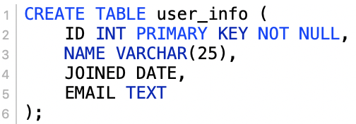
Schema
Collections of tables and information on them
Defines properties and structure of the database`
user_info
id | name | joined | email
1 | Alice | 2020-05-11 | a@abc.com
2 | Bob | 2020-05-12 | b@abc.com
3 | Charlie | 2020-05-12 | c@abc.ccom
Notes:
https://www.tutorialspoint.com/postgresql/postgresql_data_types.htm

Slide 9
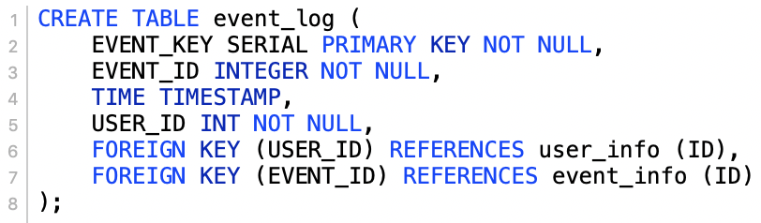
Foreign key
Schema
event_log
event_key | event_id | time | user_id
1 | 3 | 123456 | 1
2 | 2 | 123457 | 2
3 | 5 | 123458 | 3
Collections of tables and information on them
Defines properties and structure of the database`
user_info
id | name | joined | email
1 | Alice | 2020-05-11 | ...
2 | Bob | 2020-05-12 | ...
3 | Charlie | 2020-05-12 | ...
Notes:
https://www.tutorialspoint.com/postgresql/postgresql_data_types.htm

